Slide 1
Processing of Streaming Data Using AWS Services
Red Octopus - Team 7
- Anshuman Goel
- Rachit Thirani
- Vivek Varma Nadimpalli
Notes:
Good Morning everyone. We are Team 7 Red Octopus. Me along with Rachit and Vivek are going to share the details of our academic project on processing of streaming data by using AWS Services.

Slide 2
Aim
Build a pipeline to Stream & Store
Analysis using MapReduce
Explore Services provided by AWS
Notes:
The motivation of the project is to learn and explore what all we can do on cloud. We started to looking at various services provided by the AWS like S3, EC2, Kinesis, Firehose, RDS, Amazon MQ, etc. And finally decided to build a pipeline to stream large amount of data with varying velocity and storing that data in a distributed cloud environment. Later on performing analysis on that data. We have focussed to try out many technologies and frameworks in our project to get acquaint with it. Indirectly we also have to manage cost issues throughout our project which is also a critical part in any real world scenario.

Slide 3
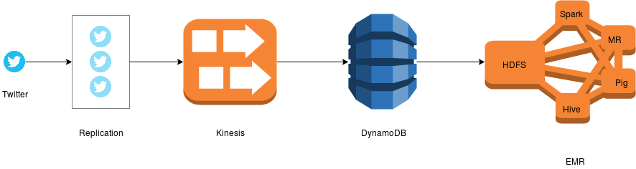
Application Architecture
Stream
Store
Move
Analysis
Notes:
Let’s look at the overall pipeline and architecture of our system from a very high level. We have used Twitter for gathering real time data. That data is being replicated multiple times to increase the volume of the data. AWS Kinesis is being used to handle such large amounts of data. Consumers threads gather data from Kinesis streams and do some kind of processing to store the results in DynamoDB. In batches the data is being copied from DynamoDB to HDFS to perform some kind of analysis on the data. Here the whole system of Hadoop has been deployed with the use of AWS Elastic Map Reduce Service.

Slide 4
Replication of Data
Fetching data from TwitterAPI
Multiple VCL machines
One process - 10 threads
Global Buffer
Replication of tweets
Velocity and Volume
Notes:
Volume and Velocity was kind of major problem in our project. Twitter generates data at 5000 tweets per second globally. According to volume of data it isn’t enough. We need to handle more. One easiest approach that we followed is through replicating the data. We reserved all the VCL machines we can to generate high volume of data with varying velocity. The replication has been done like using a producer consumer problem using a global buffer for every process.

Slide 5
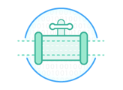
Amazon Kinesis
Streaming service
Collect and Process
Real time
Distributed
Shards
Pricing - Based on shards reserved
Notes:
To handle that high volume of data we use AWS Kinesis. It is a streaming service provided to collect and process data in real time. It is very similar to Kafka. It also has a push pull model. It has shards which are basically like queues. We connect to those queues and fetch data from it. The pricing of Kinesis is based on the the number of shards you reserve in your stream. The shards have varying read and writing speed. One can write into shard at a maximum of 1 MB/s and can read at a speed of 2 MB/s. While pushing data one has to keep ensure that data is being divided to every shard in balance.

Slide 6
Using Kinesis
Process & Threads
Data Stream
Unique Sequence Number
Shards – Queue
Read/Write Limitations
MD5 Hashing
Notes:
The threads that are replicating the data within the process have to push the data to Kinesis shards in a balance format so that they don’t exceed the limitation of read/write limits. How it was achieved to balance load on each shards ? Firstly determining the shard where the process has to write the data. Kinesis uses MD5 hashing to determine the shard no. We dynamically calculate the hash and explicitly puts the data into the shard. And after careful performance tuning we are able to generate the data with large volumes and with varying velocity. Also, Kinesis by itself assigns a unique sequence number to each of the record stored in it which later on helps in our processing too.

Slide 7
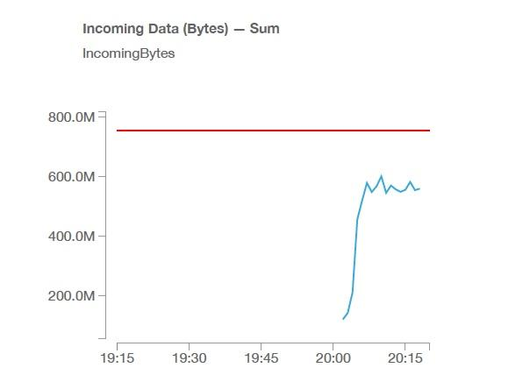
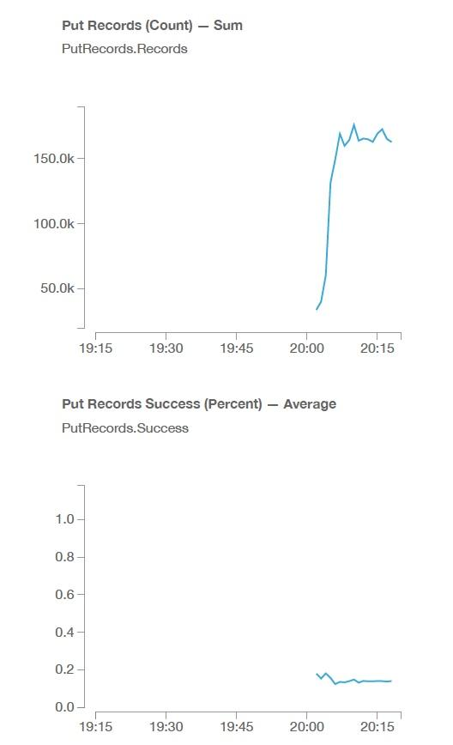
Notes:
In our setup we prefer to choose using 11 VCL machines with 11 shards to generate one to one mapping. The slide shows the results of the volume and the velocity with which the data is being generated. These two graphs shows the speed at which we are able to generate and push the data into Kinesis. The graph on the left we can see that on average we are able to generate the data between 600 to 800 MB/min through replication and load balancing which accounts for more than 150,000 records per minute.

Slide 8

Amazon DynamoDB
Cloud Database service
NoSQL
Key-value & Document store Models
Scalable
Reliable
Pricing
Capacity Units
Auto Scaling
Notes:
DynamoDB is a NoSQL cloud database service provided by AWS, which supports key-value and document store models, with latency in milliseconds even at large scale. Its flexible data model, reliable performance, and automatic scaling of throughput capacity, makes it a great fit for low latency application like gaming. It is also highly scalable, a requirement in the industry.
Writing data to DynamoDB can also be complex task like Amazon Kinesis. Just like the limits on reading and writing in the shards, DynamoDB has capacity units for reading and writing. One has to specify the proper number of capacity units such that DynamoDB doesn't throttle down due to heavy number of requests. The reading capacity units can be read at the speed of 20 to 40 KB/s depending upon the consistency model and can write at a speed of 5 KB/s.

Slide 9
Using DynamoDB
Creating Table
Key as Sequence Number
Reading data from shards
Filtering records on the fly
Auto Scaling
Read/Write limit
Store data
Notes:
We create a table in dynamoDb with the metadata with key as sequence number. We took the data from kinesis queue and if the data had all the fields which are required, we wrote the data into the dynamodb table.

Slide 10
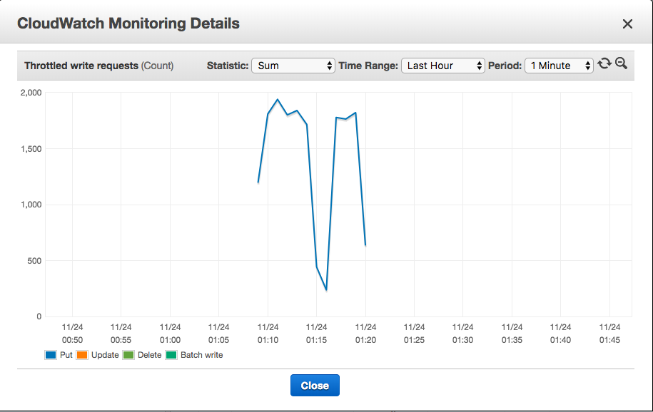
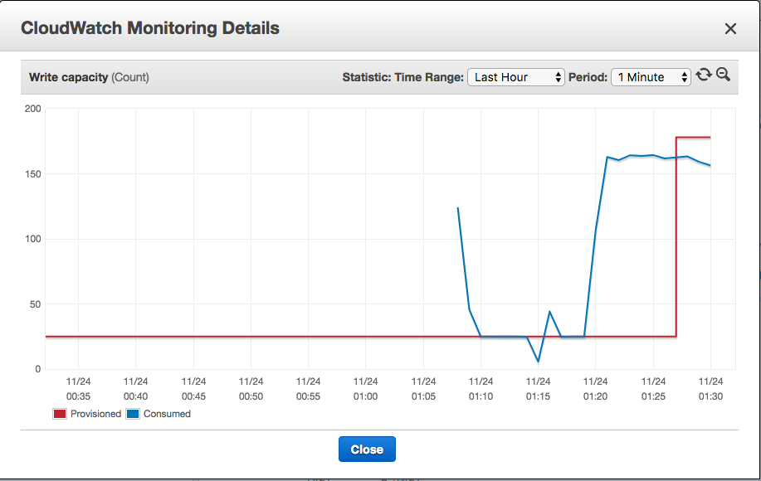
Notes:
these are the graphs which represent the auto-scaling

Slide 11
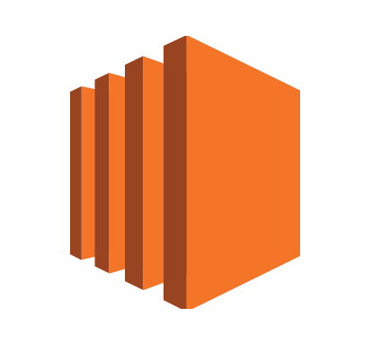
Amazon Elastic Compute Cloud (EC2)
VM machines
Secure
Saves Time
Saves Money
Notes:
EC2 is a service provided by amazon with facilitates setting up of virtual machines easily and when required. SSH or aws console is required to connect to the vm.. we have an option of specifying a key value pair which can be used to connect to the vm. it also provides an option of selecting vm with specific configuration related to the processing speed and storage required and charges us based on the configuration selected.

Slide 12

Amazon Elastic MapReduce (EMR)
Hadoop cluster
Big data
Dynamic
Variety of frameworks
Notes:
emr services directly provide us with an option of selecting the number of nodes and the configuration of the nodes or the cluster which will be offered by ec2.
it also provides an option to select the pre installed frame works, saving the time in un necessary installations. with just a few clicks, we can select the frameworks which we need and they get installed in the cluster.

Slide 13
Using Hive
Transferring data from DynamoDB to HDFS
Feature Selection
Modification and Cleaning
Analysis
Summarization and Result
Notes:
hive was used for movement of data from dynamodb to hdfs .
hive is a sql like language which makes the work easier as it requires not much knowledge about programming. we used hive by mapping the table in HDFS to the table in Dynamodb and with just one command all the data was copied. while copying the data from dynamodb we modified the data based on the requirements, like breaking down of words and sentences and selected the specific cols which were required for analysis.

Slide 14
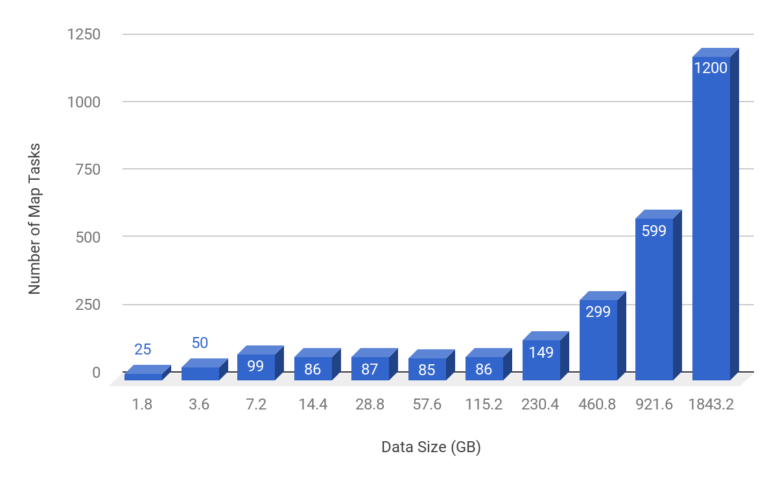
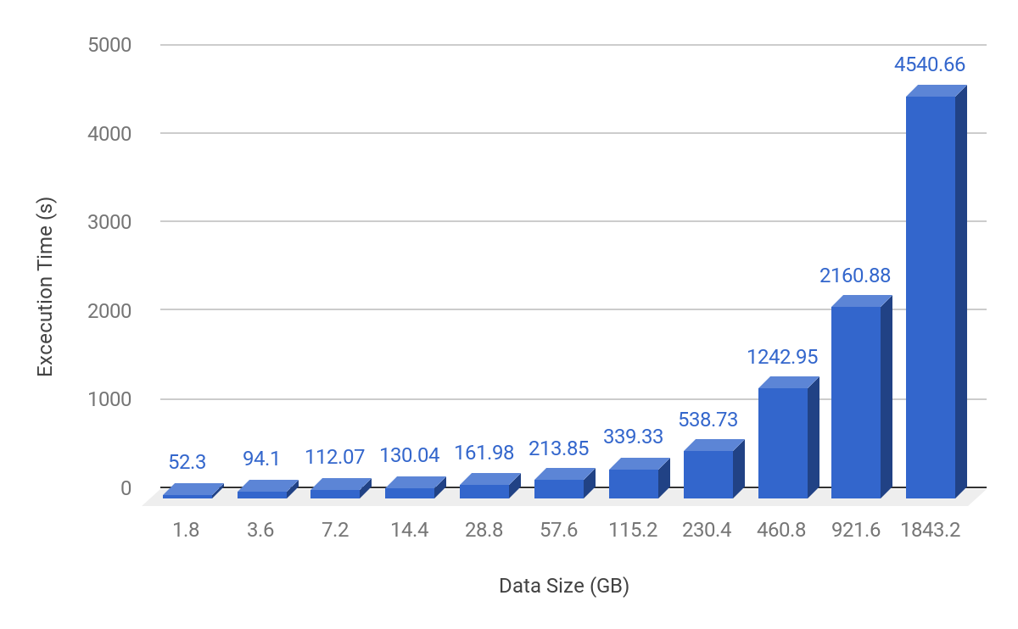
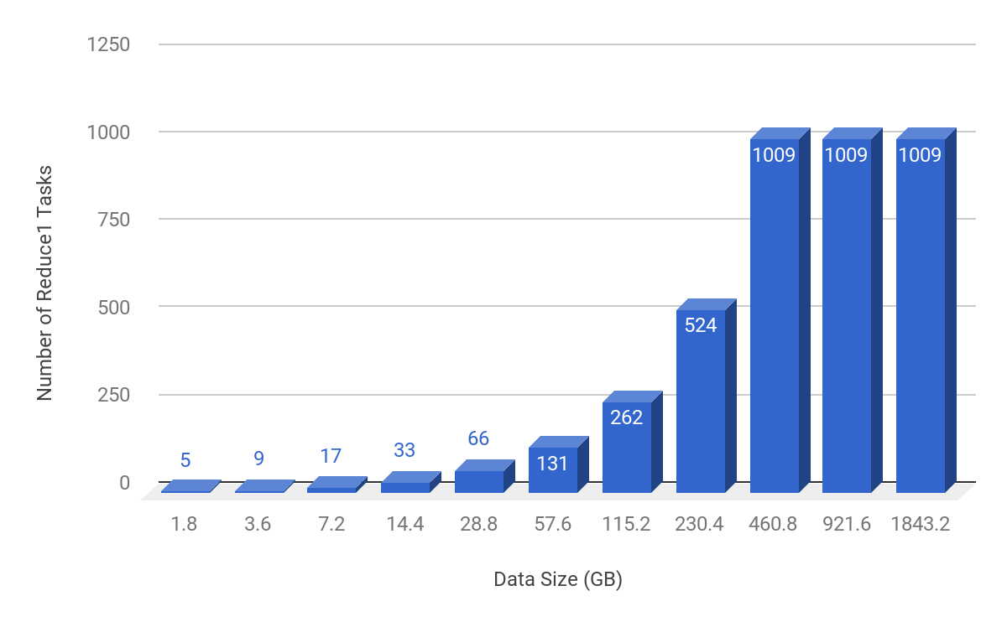
Results
Notes:
we have used m1.xlarge systems which has 4 vCPU with 15 GB RAM and 1680 GB SSD storage space. as we can see from the figure, for map tasks, the number is constant until a point, where as it doubles as the data is increased. this is because map is a distributed task, and as the data size increases, we need more map tasks to dive the data and work on the data. this increases the speed and parallely the computations are done on the different segments of data.
for the reduce tasks, the number increases, but after the increase in data after a point, the reduce tasks remain constant. this is because for reduce tasks to start their work, they need data from the map tasks. Number of reduce tasks are
the total execution time doubles. because after the reduce tasks have performed their function, they have to collect the data from the reduce tasks and consolidate them to present the analysis of the mapreduce task.

Slide 15
Alternatives
Analysis during streaming
Analysis without DynamoDB
Pig for analysis
Spark for analysis
Notes:
alternative approaches:-
analysis on the data could have been done during streaming using Kinesis firehouse.
the data could have directly be moved to hdfs instead of moving it to dynamodb and then to hdfs. but we wanted to explore as many services as we could and we chose the road not taken
we took some small data set and did some analysis using pig and spark which is also an option which can be used. there are positives and drawbacks of all the different frameworks.

Slide 16
Thank you
Notes:
any questions?
we would like to thank the prof for introducing us to Amazing aws. indeed this was a learning experience and we explored new horizons.
thanks you

